Slide 1

Derivative Product Rule
RCET 0264 Introductory Calculus
Tim Leishman

Slide 2
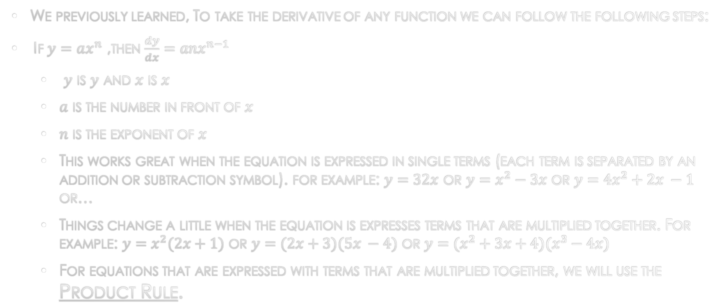
Derivative Product Rule
We previously learned, To take the derivative of any function we can follow the following steps:
If $y=ax^{n}$ ,then $\frac{dy}{dx}=anx^{n−1}$
$y$ is $y$ and $x$ is $x$
$a$ is the number in front of $x$
$n$ is the exponent of $x$
This works great when the equation is expressed in single terms (each term is separated by an addition or subtraction symbol). for example: $y=32x$ or $y=x^{2}−3x$ or $y=4x^{2}+2x −1$ or…
Things change a little when the equation is expresses terms that are multiplied together. For example: $y=x^{2}(2x+1)$ or $y=(2x+3)(5x −4)$ or $y=(x^{2}+3x+4)(x^{3}−4x)$
For equations that are expressed with terms that are multiplied together, we will use the Product Rule.

Slide 3
Derivative Product Rule
Product Rule: The derivative of a product is equal to the derivative of the first (product) multiplied to the second (product) then added to the first (product) multiplied to the derivative of the second (product).

Slide 4
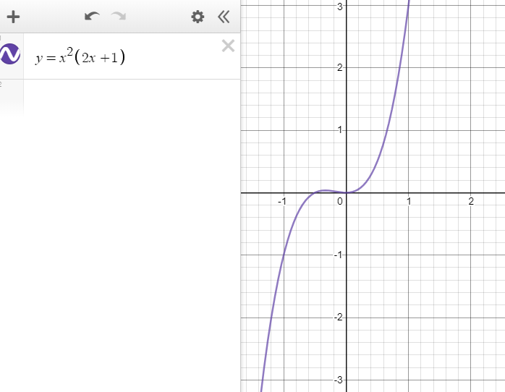
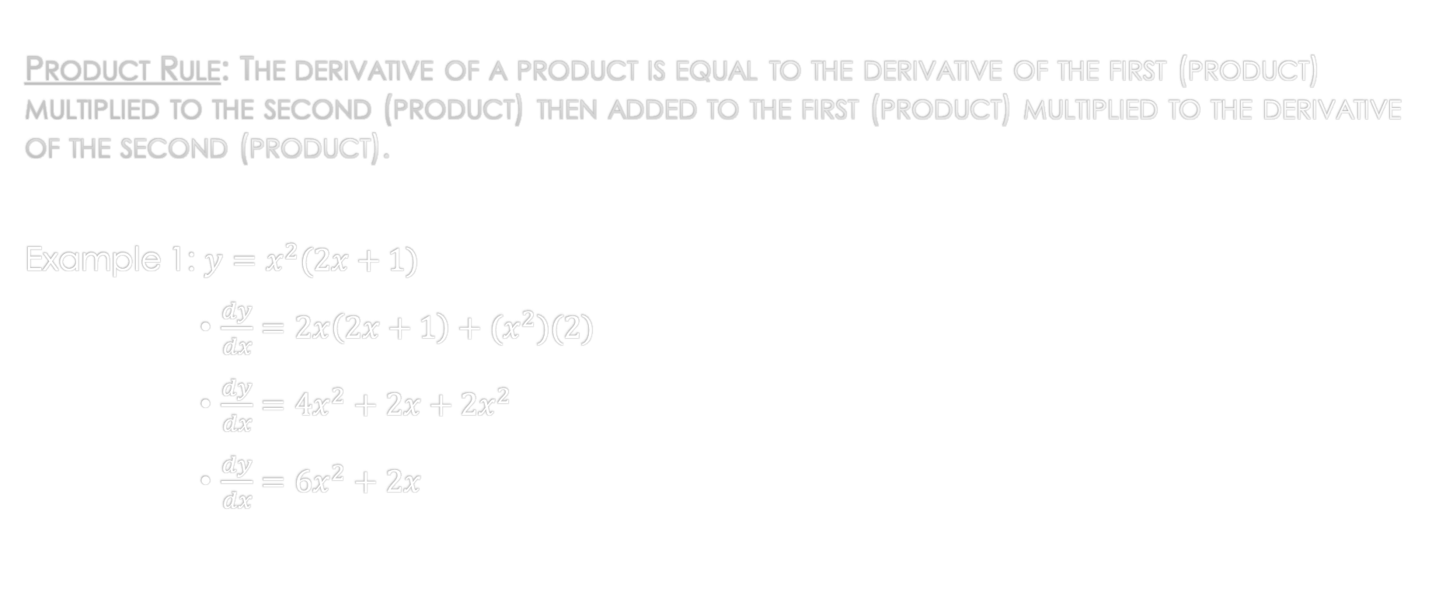
Derivative Product Rule
Product Rule: The derivative of a product is equal to the derivative of the first (product) multiplied to the second (product) then added to the first (product) multiplied to the derivative of the second (product).
Example 1: $y=x^{2}(2x+1)$
$\frac{dy}{dx}=2x\left(2x+1\right)+(x^{2})(2)$
$\frac{dy}{dx}=4x^{2}+2x+2x^{2}$
$\frac{dy}{dx}=6x^{2}+2x$

Slide 5
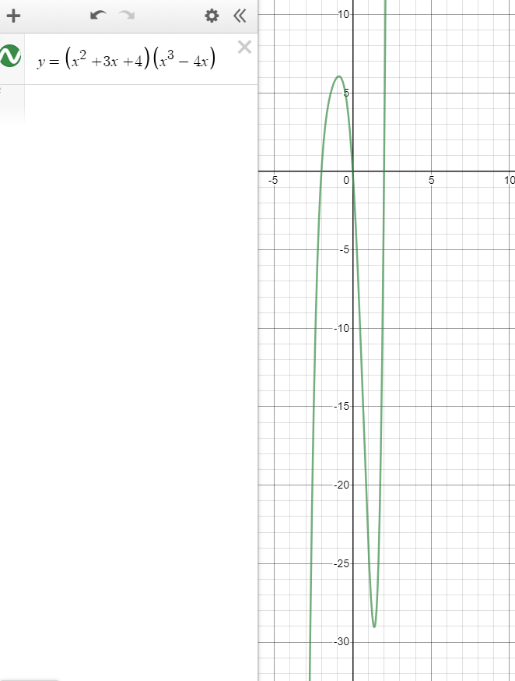
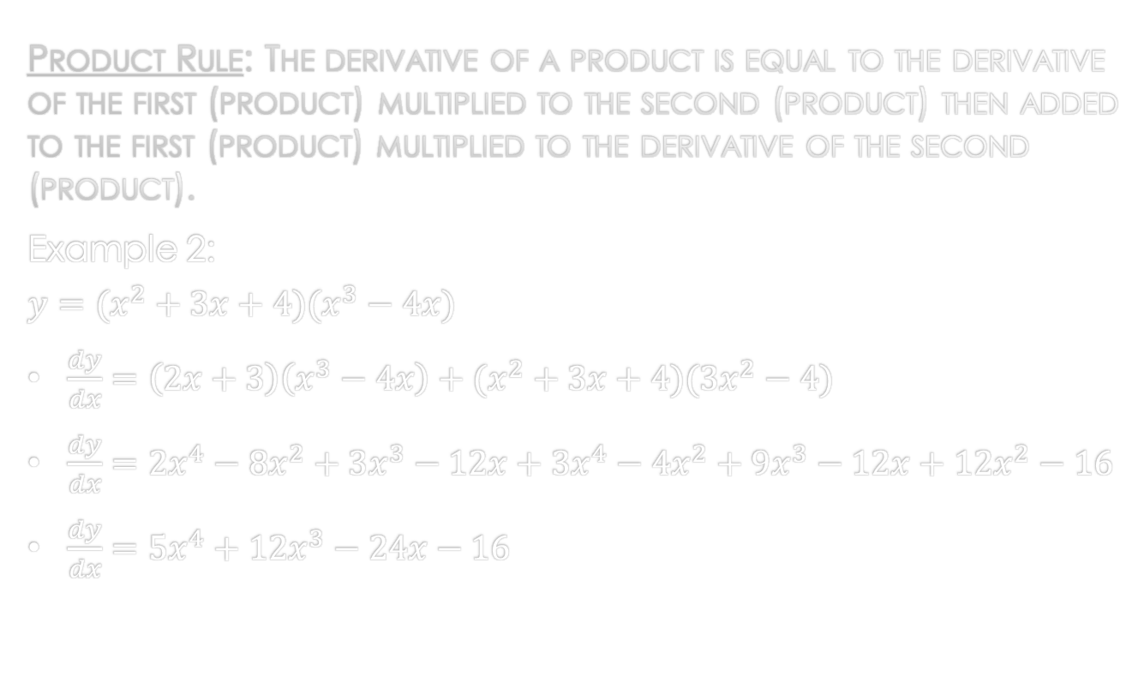
Derivative Product Rule
Product Rule: The derivative of a product is equal to the derivative of the first (product) multiplied to the second (product) then added to the first (product) multiplied to the derivative of the second (product).
Example 2:
$$y=(x^{2}+3x+4)(x^{3}−4x)$$
$\frac{dy}{dx}=\left(2x+3\right)\left(x^{3}−4x\right)+(x^{2}+3x+4)(3x^{2}−4)$
$\frac{dy}{dx}=2x^{4}−8x^{2}+3x^{3}−12x+3x^{4}−4x^{2}+9x^{3}−12x+12x^{2}−16$
$\frac{dy}{dx}=5x^{4}+12x^{3}−24x−16$

Slide 6
References:
Ewen, D., Gary, J. S., & Trefzger, J. E. (2005). Technical calculus. Upper Saddle River, NJ: Pearson/Prentice Hall.
Richmond, A. E., & Hecht, G. W. (1995). Calculus for electronics. New York: Glence.
https://www.desmos.com

